Slide 1

PD For SA K-12 Teachers

Slide 2
Content Structure
Responsible AI
AI in SA
AI in Emotional Leadership Skills
Community

Slide 3
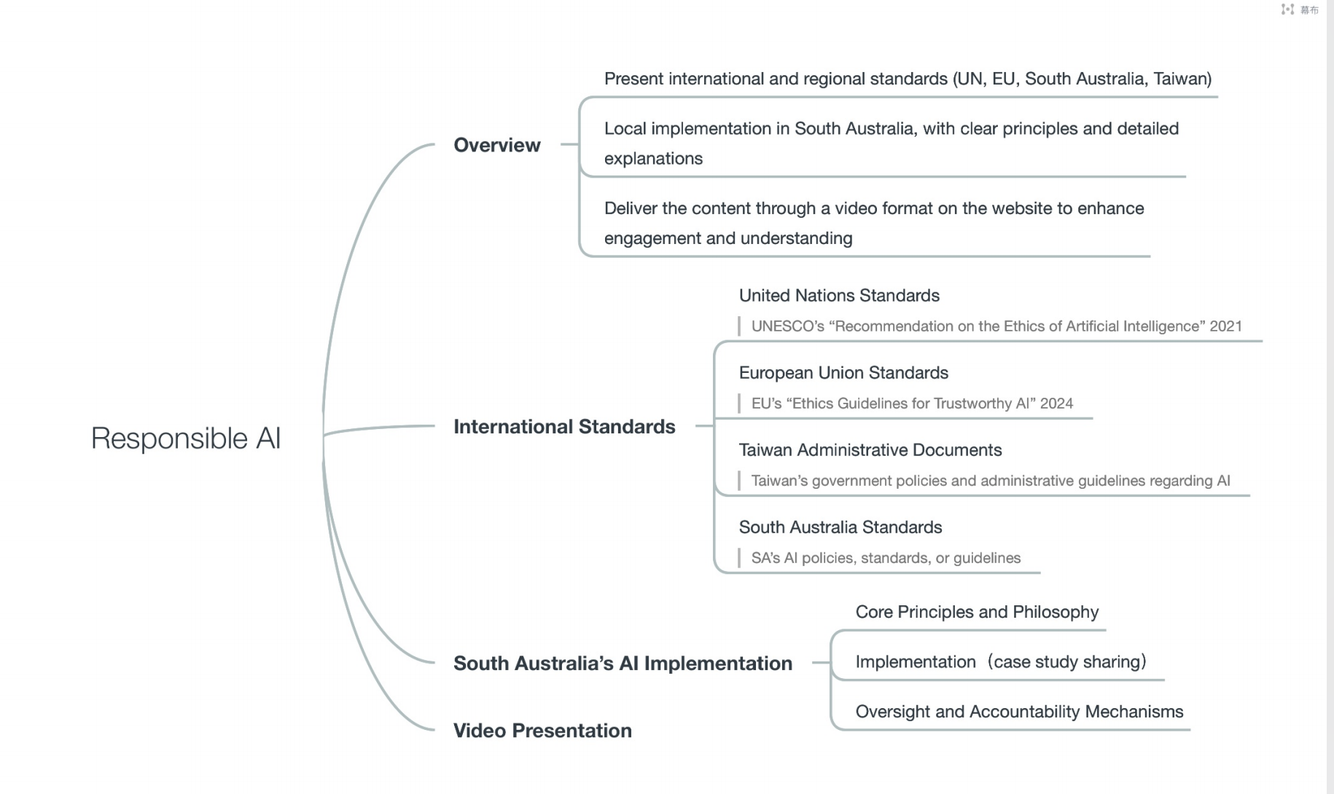
Responsible AI

Slide 4
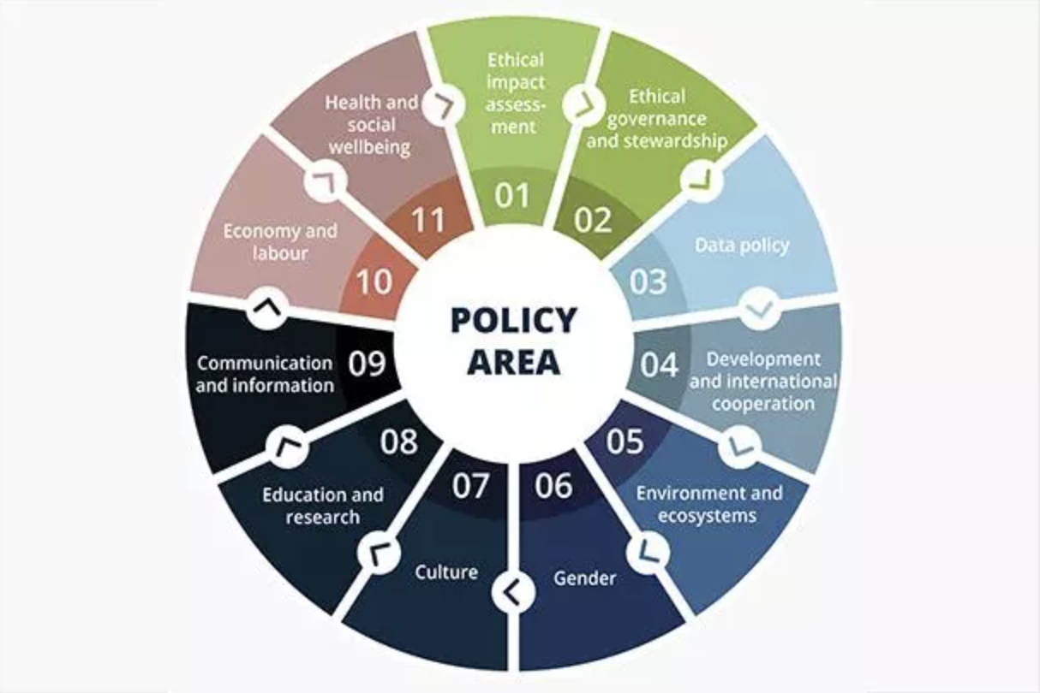

Slide 5
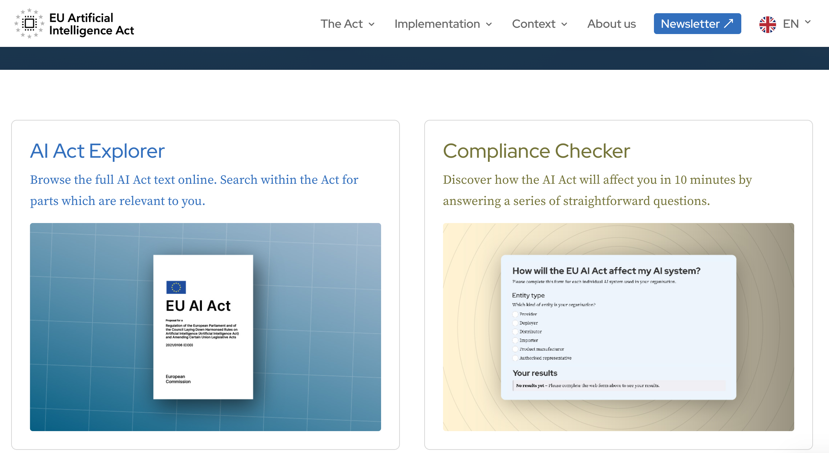

Slide 6
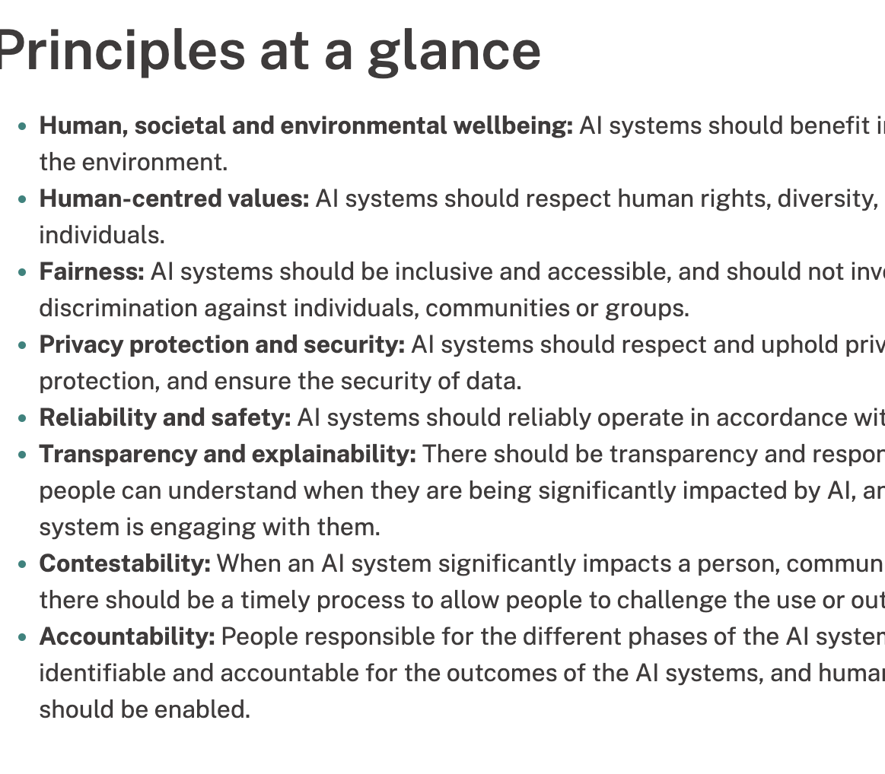
Australia’s AI Ethics Principles

Slide 7
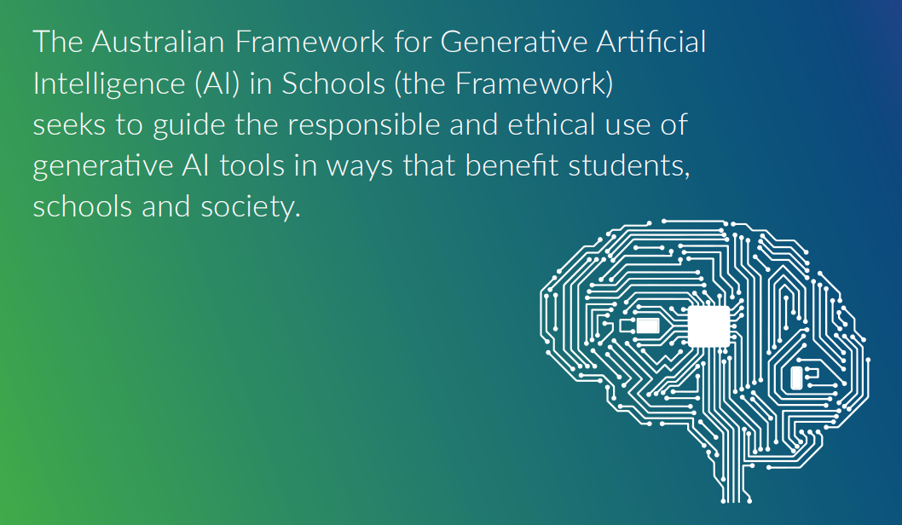
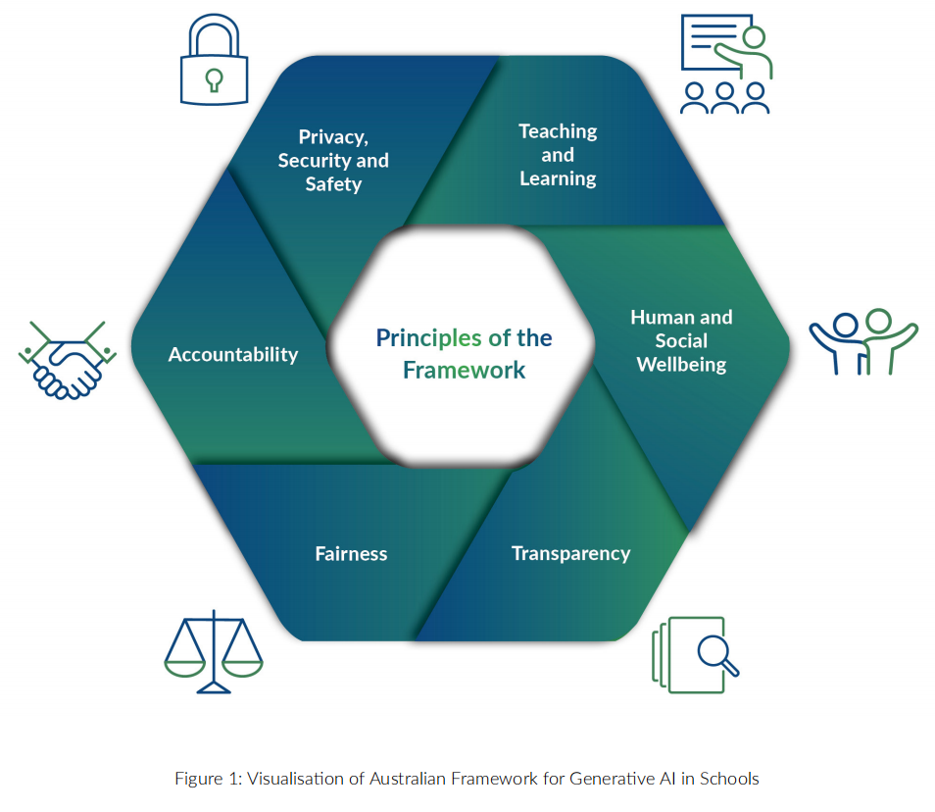

Slide 8
How to transform the existing educational process using AI
Fundamental Knowledge of Large Model AI (Main)
01
AI Tools
02
AI Teaching Strategies
03
Case studies (Main)
04

Slide 9
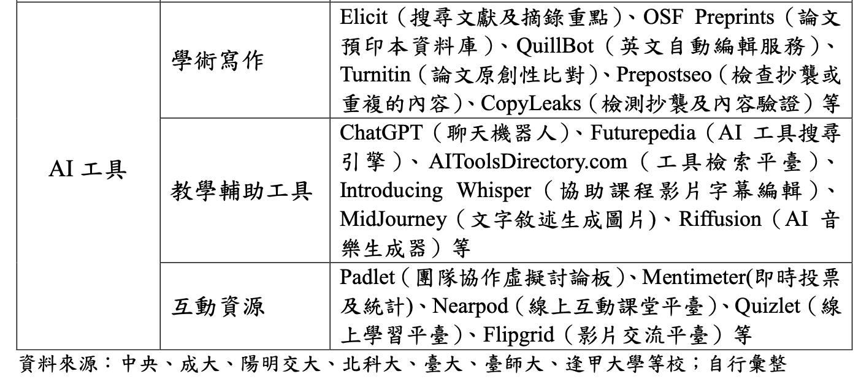
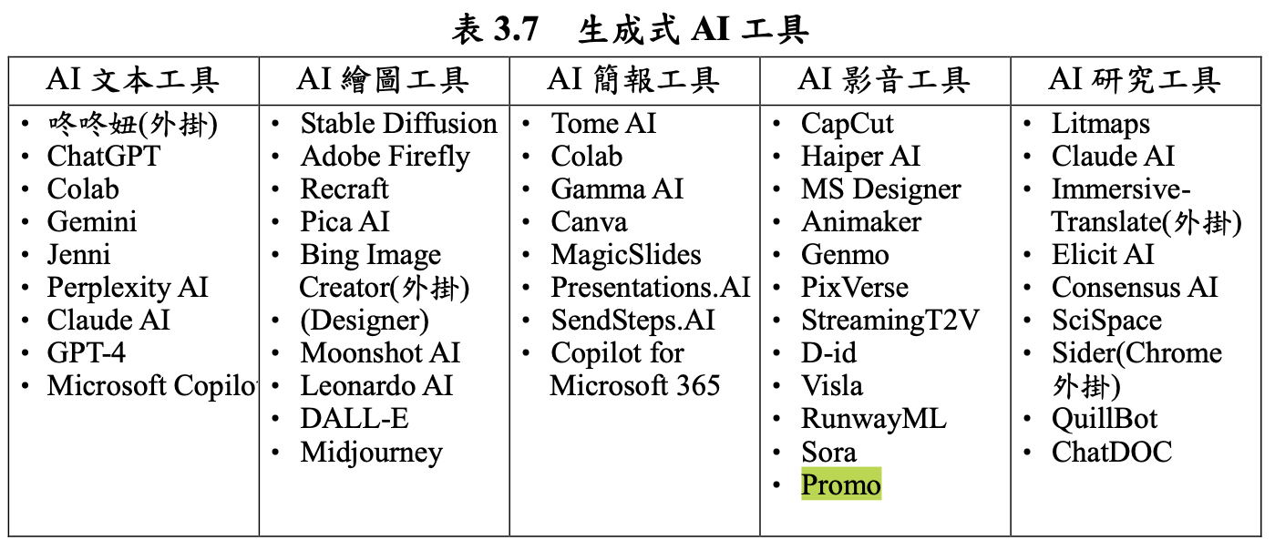
1. Map of AI (Course-Video)
What is AI
How to use AI in teaching
How to prompt to get better answer from AI

Slide 10
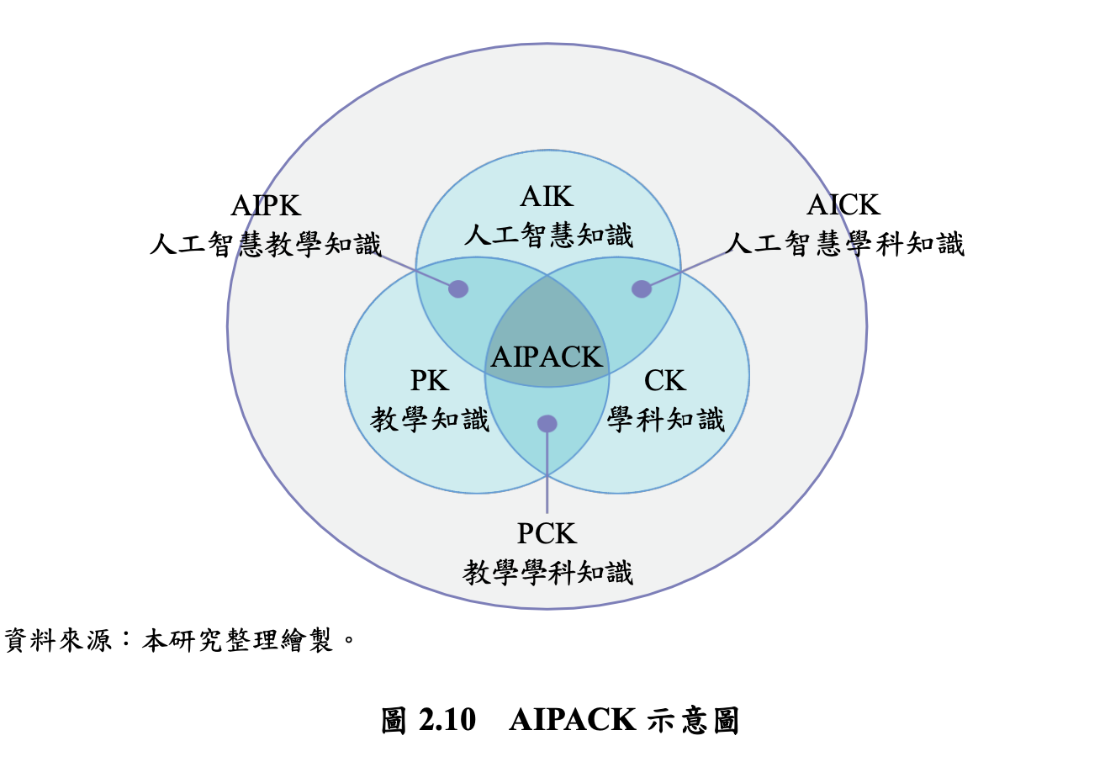
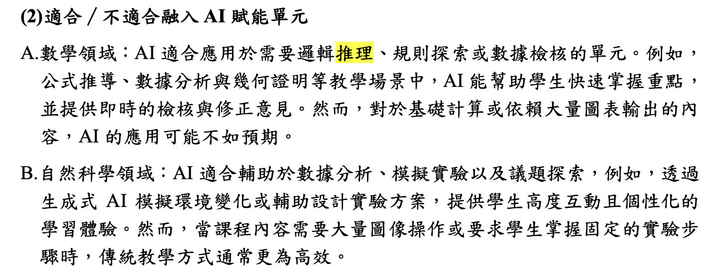
2. Learning with Ai(Course –Video)

Slide 11
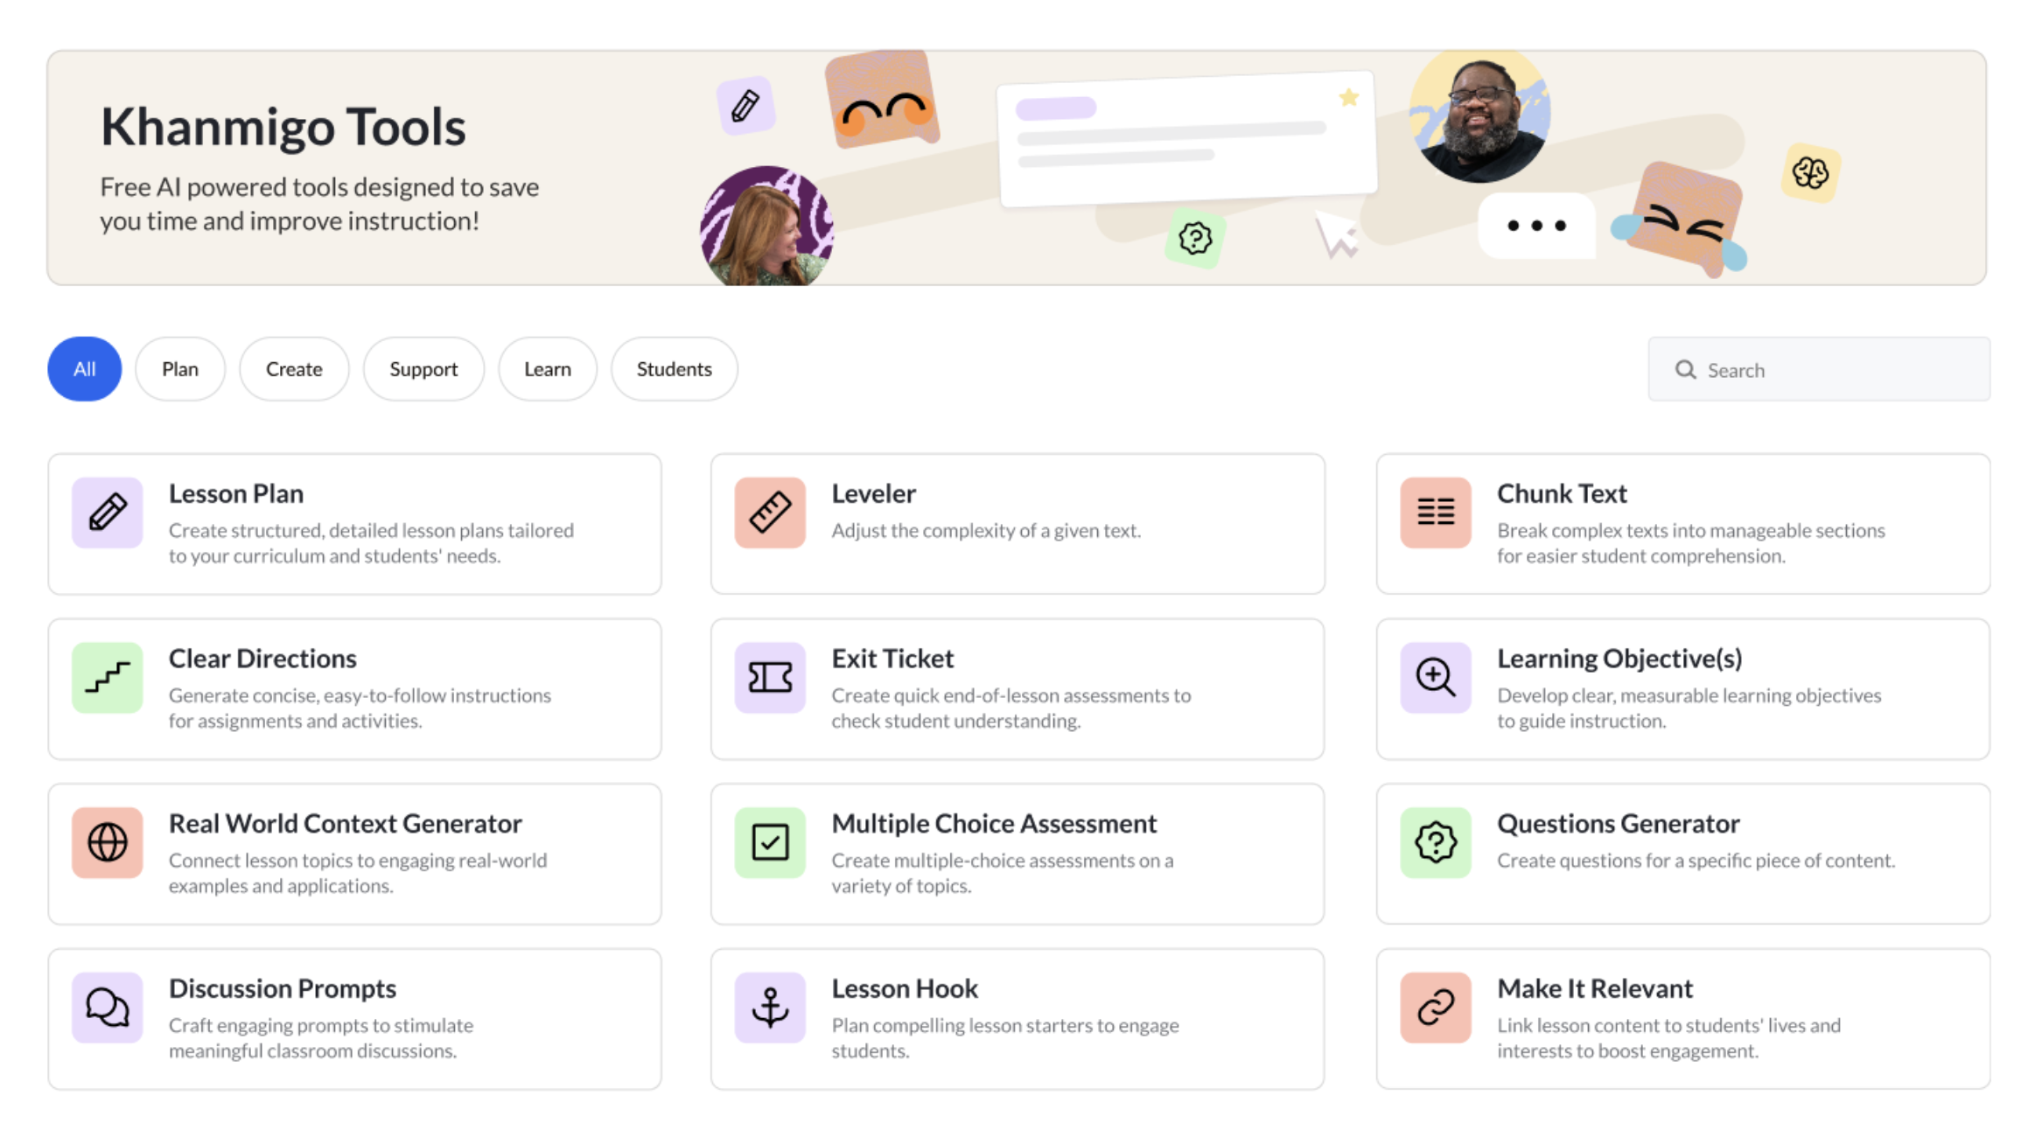
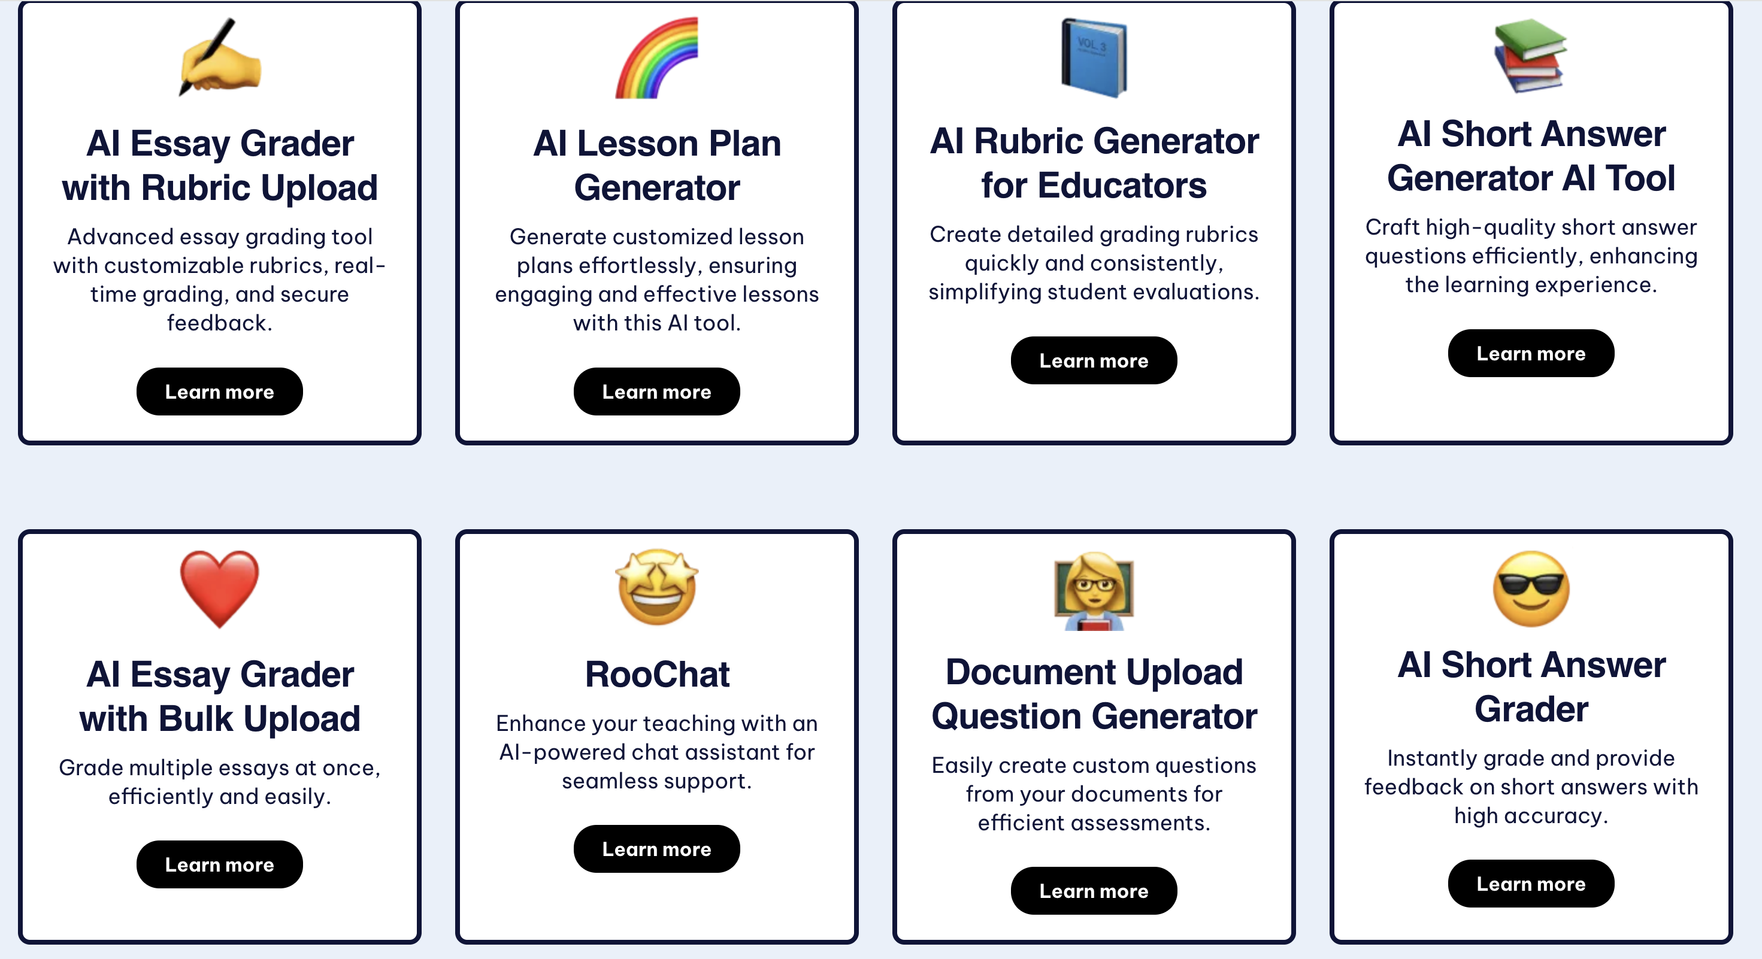
3. Work with Ai (Ai tools)

Slide 12
4. AI case example-Maths: positive and negative numbers
Teaching process | Digital tools | AI in use
Teacher-student interaction | N/A | N/A
Group activity | Use Canva for recording ideas | N/A
AI help to correct mathematical Principles | N/A | Use AI to correct students' math principles and give feedback
Reflect on AI results | ChatGPT | Use ChatGPT to check students' math principles and let students reflect whether AI's results are correct
Group discussion | N/A | N/A
Group tasks: Create a life situation where there are positive and negative numbers and point out the areas of positive and negative numbers | ChatGPT, Canva | Use ChatGPT to assess if it's correct and make charts on Canva

Slide 13
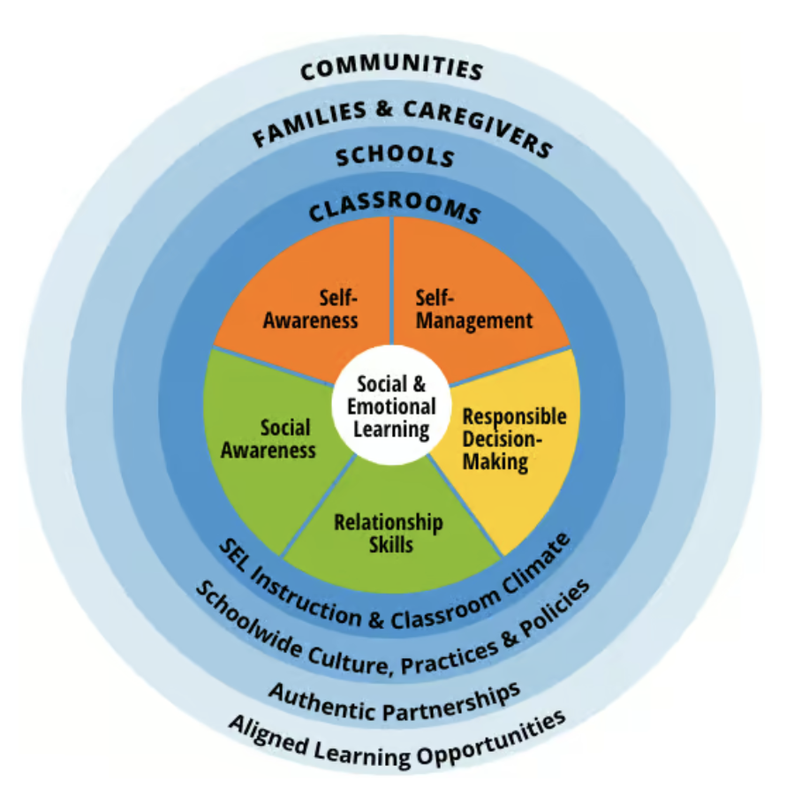
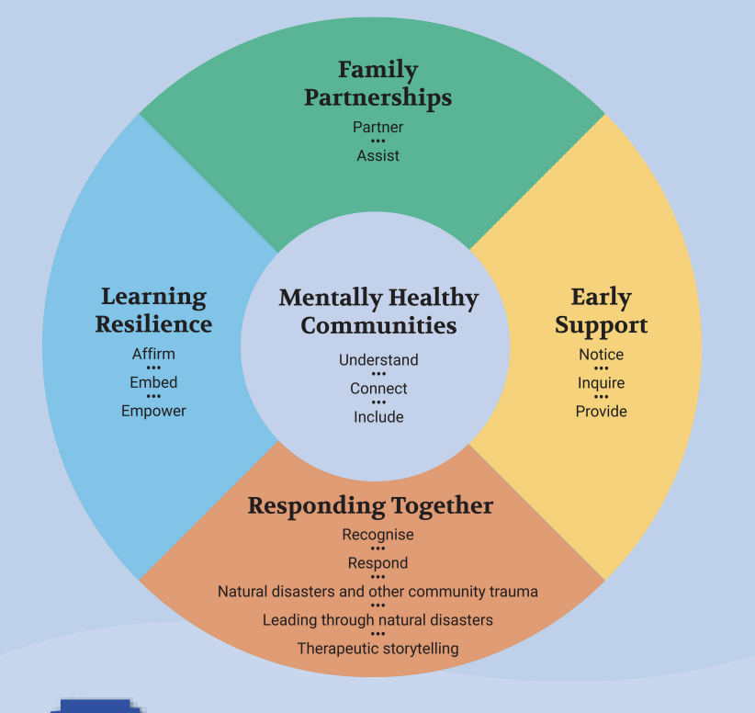
AI in Emotional Leadership Skills
Integrating SEL and Be You Framework
CASEL Wheel
Be You Framework

Slide 14
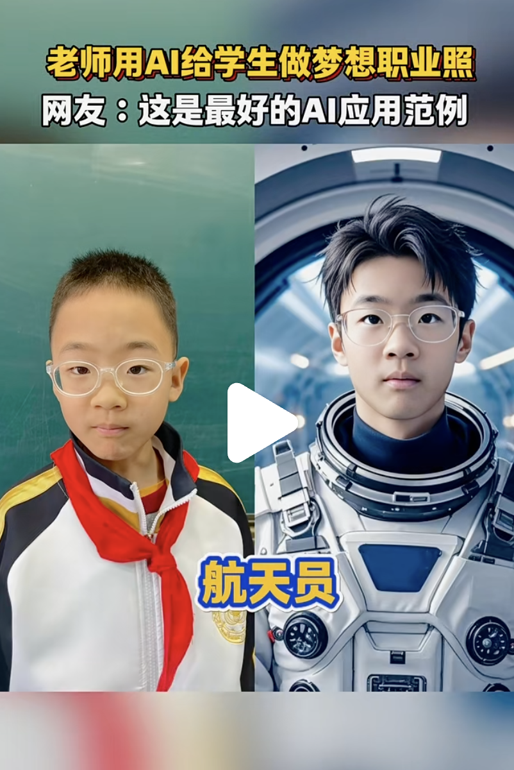
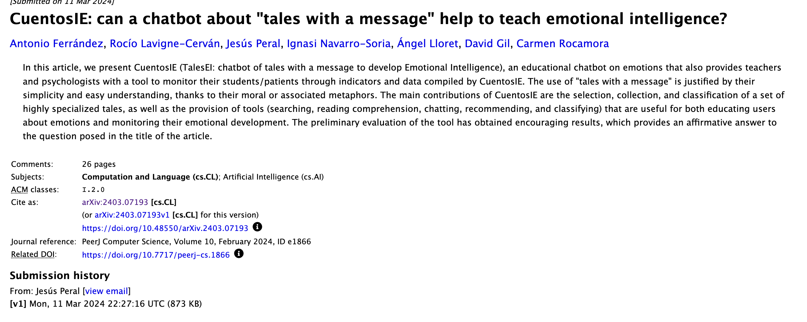
Self-awareness & Management
CuentosIE
Be You -->. Notice

Slide 15
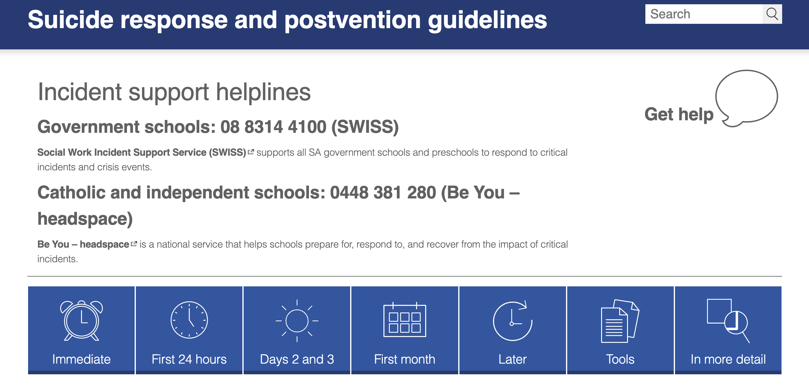
Resilience and Coping Skills
Case and prompt
Be You -> Critical Incident Response

Slide 16

Relationship Skills

